Slide 1
Database Keys
Annie Chiu
Elena Liao
Javier Pacheco

Slide 2
Today’s topic
Recap of 3 Major Keys
Primary Key, Unique Key, Foreign Key
Advance settings for the foreign key
More Keys
Candidate Key
Super Key
Composite Key
Alternative Key
- Kahoot!

Slide 3
A DATABASE
is a collection of data stored in a formation that can easily be accessed.

Slide 4

Relational Database
Store data in tables that are linked to each other using
relationships (keys)
So, Keys is a Key in the relational database!!!
Students
Classes
Grades
BAM!!!!!!

Slide 5
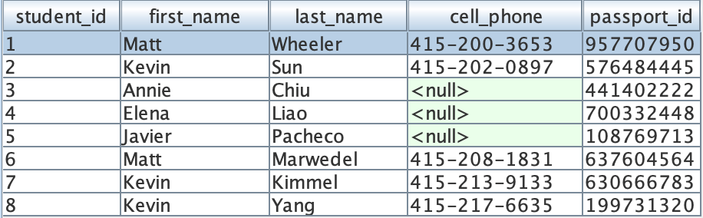
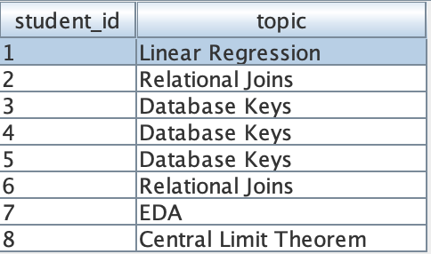
Recap of 3 Major Keys
Primary Key
Unique Key
Unique Key
Foreign Key

Slide 6
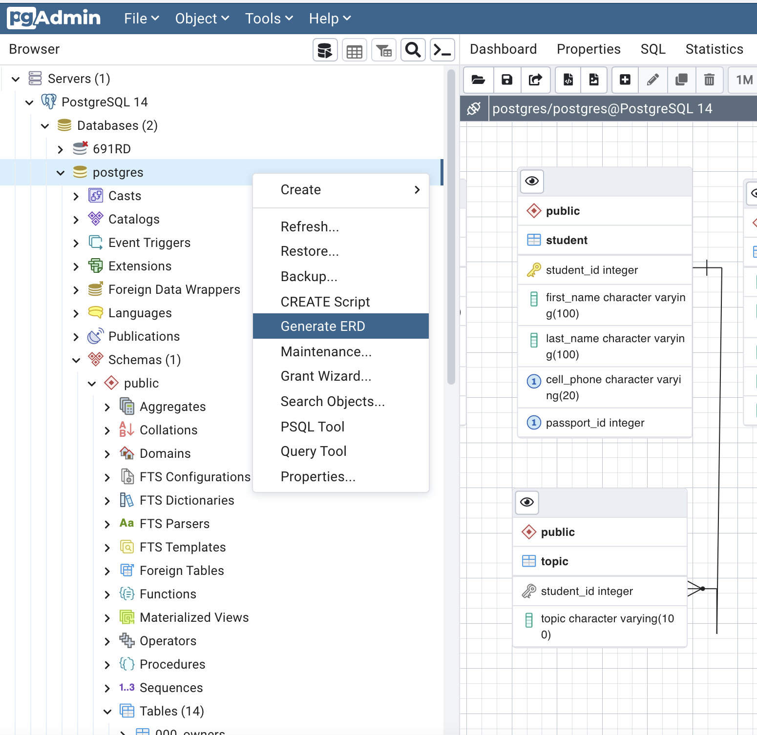

Slide 7

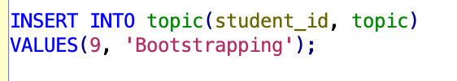
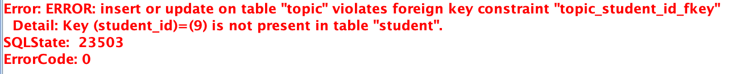
Foreign Keys Constraints
In the previous lecture…
Two situation that will lead to database errors
Delete a primary key when it is referred by a foreign key in the children table
Add a foreign key in the children table when it does not exist in the parent table

Slide 8
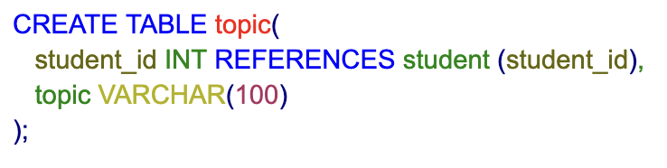
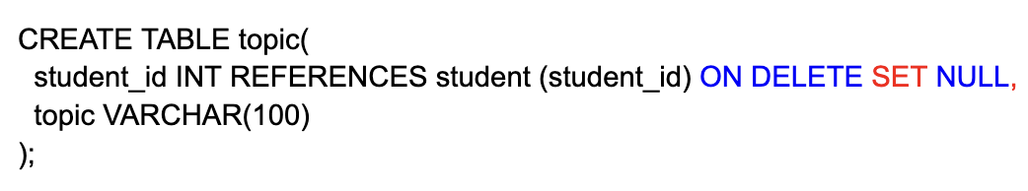
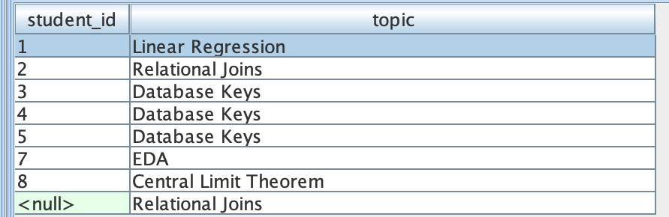
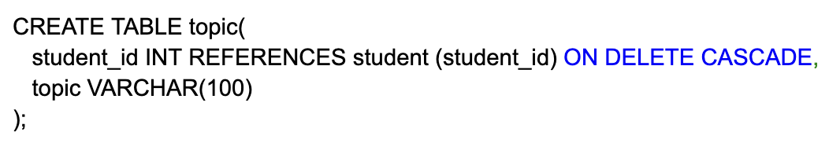
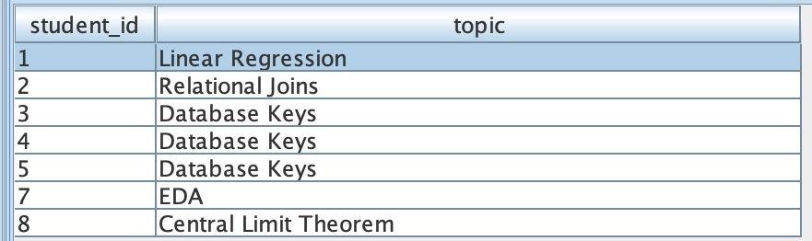
Foreign Keys Constraints
Tips to avoid error messages
Change the foreign key to null value and keep the record in the children table
Delete the record in the children table
Keep in mind that error messages exist with a purpose

Slide 9
More Keys
Terminology alert!!!

Slide 10
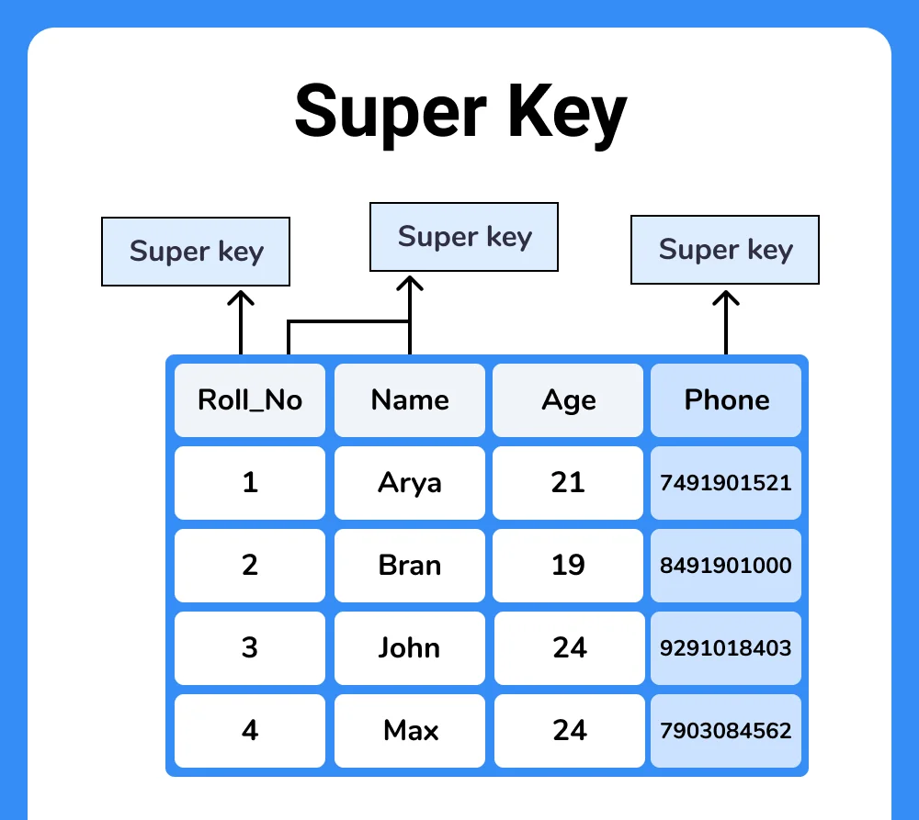
Super Key
A super key is a combination of the attribute(s) to recognize a unique record.
So, it could be one column, or multiple columns, or even all the columns in the table. It only need to contain at least one unique key.
Roll_No
Roll_No + Phone
Roll_No + Name + Age
Roll_No + Name + Age + Phone
etc….

Slide 11
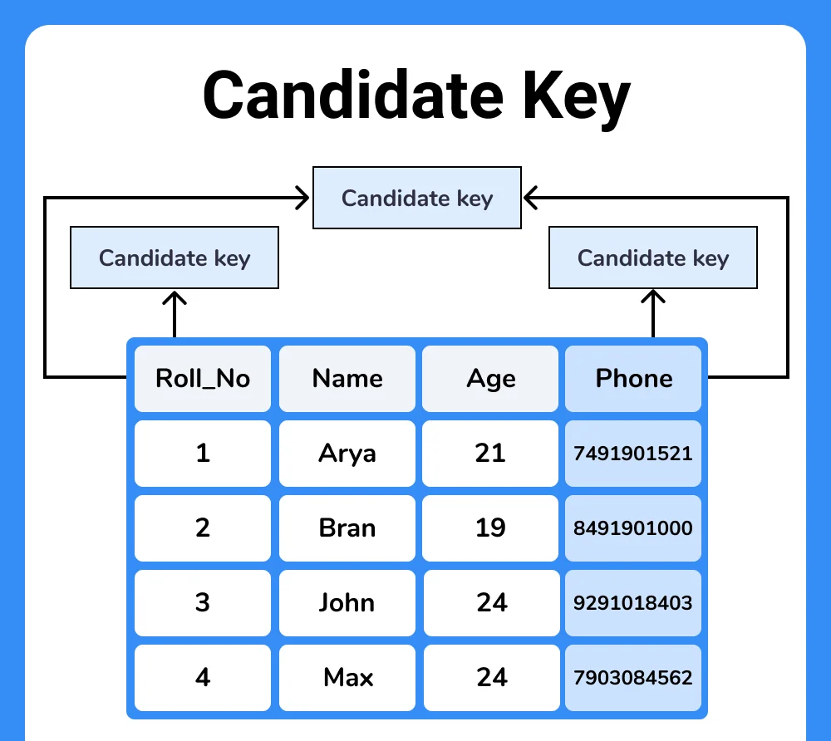
Candidate Key
Candidate key is a subset of super keys that are without any unnecessary attributes (like "Name" and "Age")
Therefore, the Super key may be reduced to just one field, Roll_No or Phone, which are the candidate key.
Candidate
Primary
Alternate

Slide 12
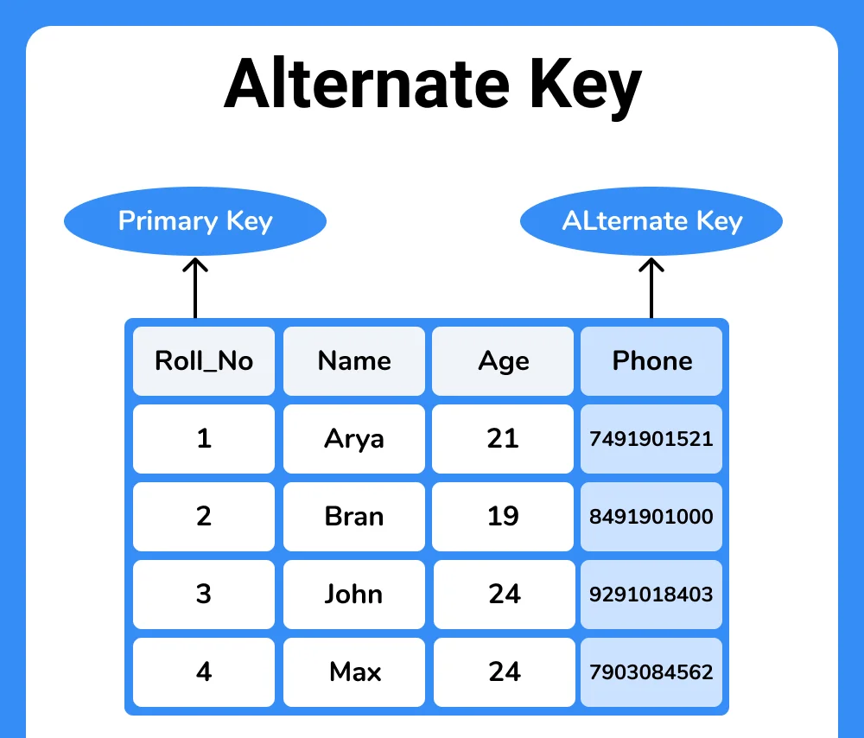
Alternate Key
The primary key is the candidate key with minimum attribute(s) selected by the database owner based on the user's habit.
And the rest of the candidate keys(“Phone”) are the alternative keys

Slide 13
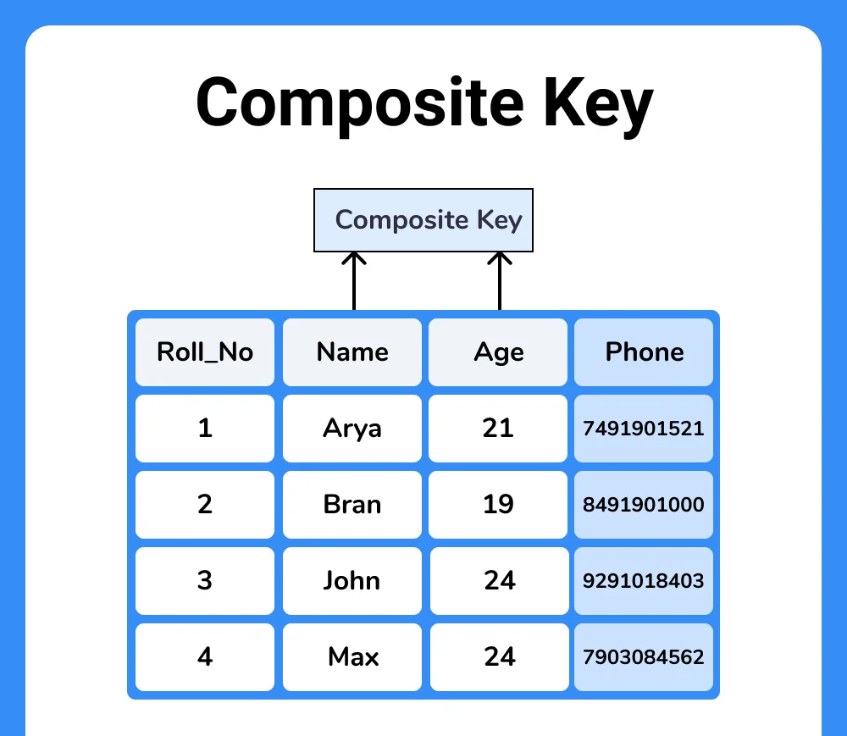
Composite Key
A composite key consists of two or more attributes that together uniquely identify an entity occurrence.

Slide 14
Kahoot! Time

